Slide 1
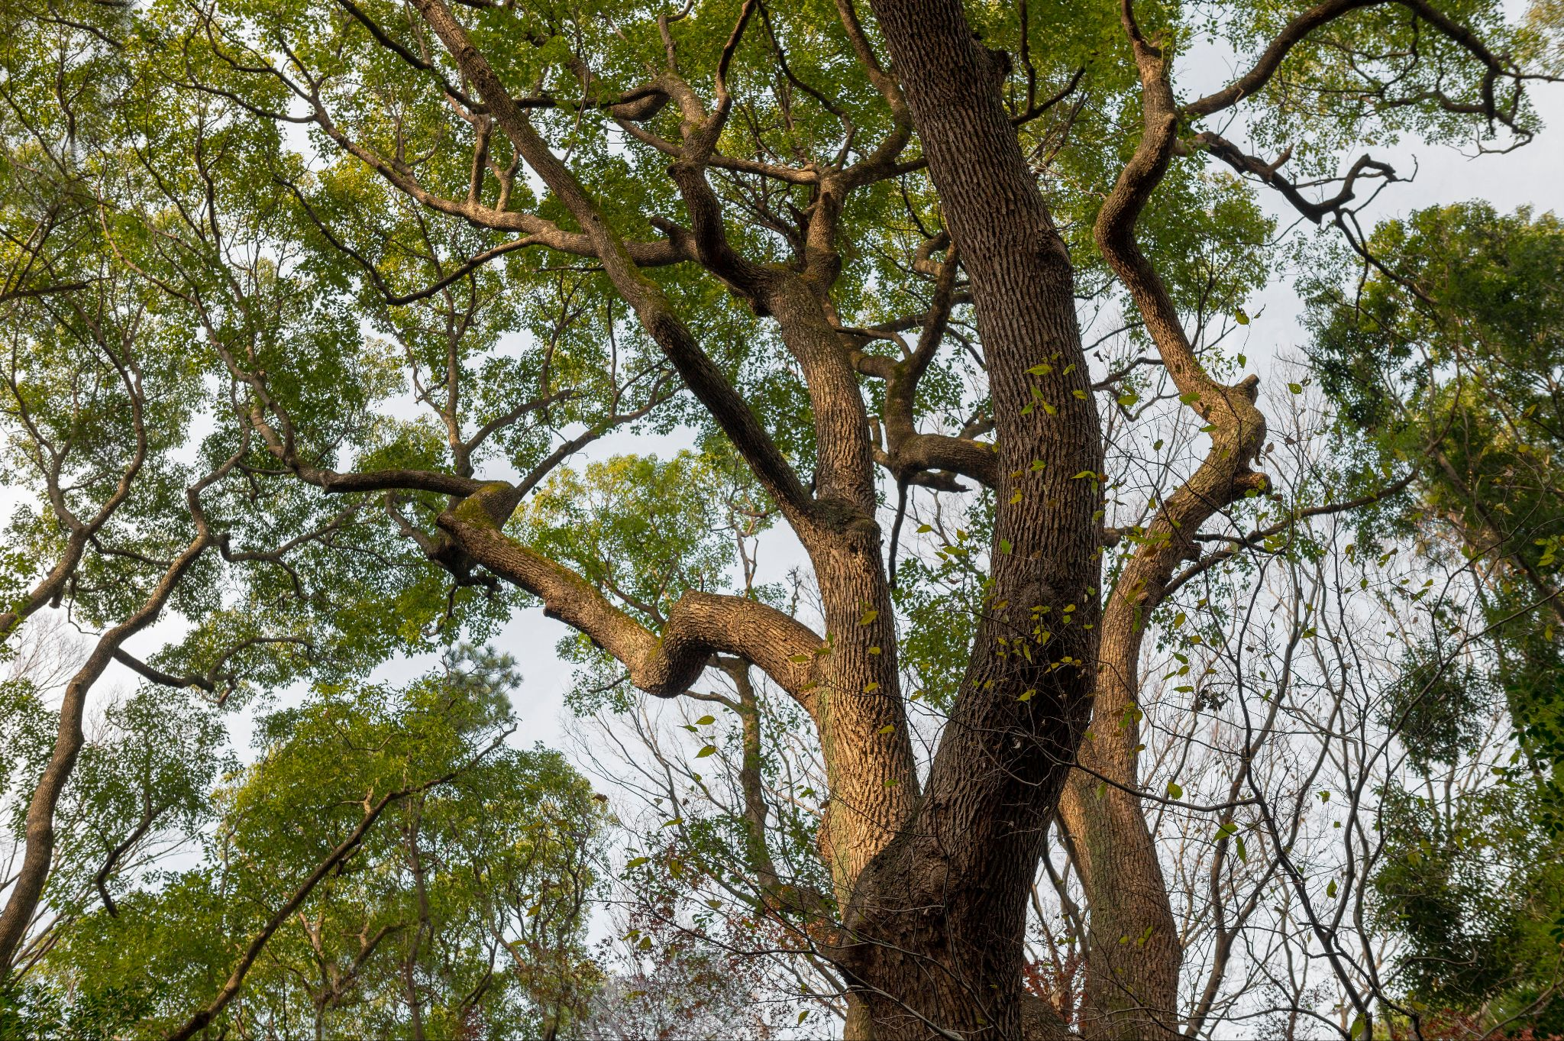
Reforestation and Afforestation

Slide 2
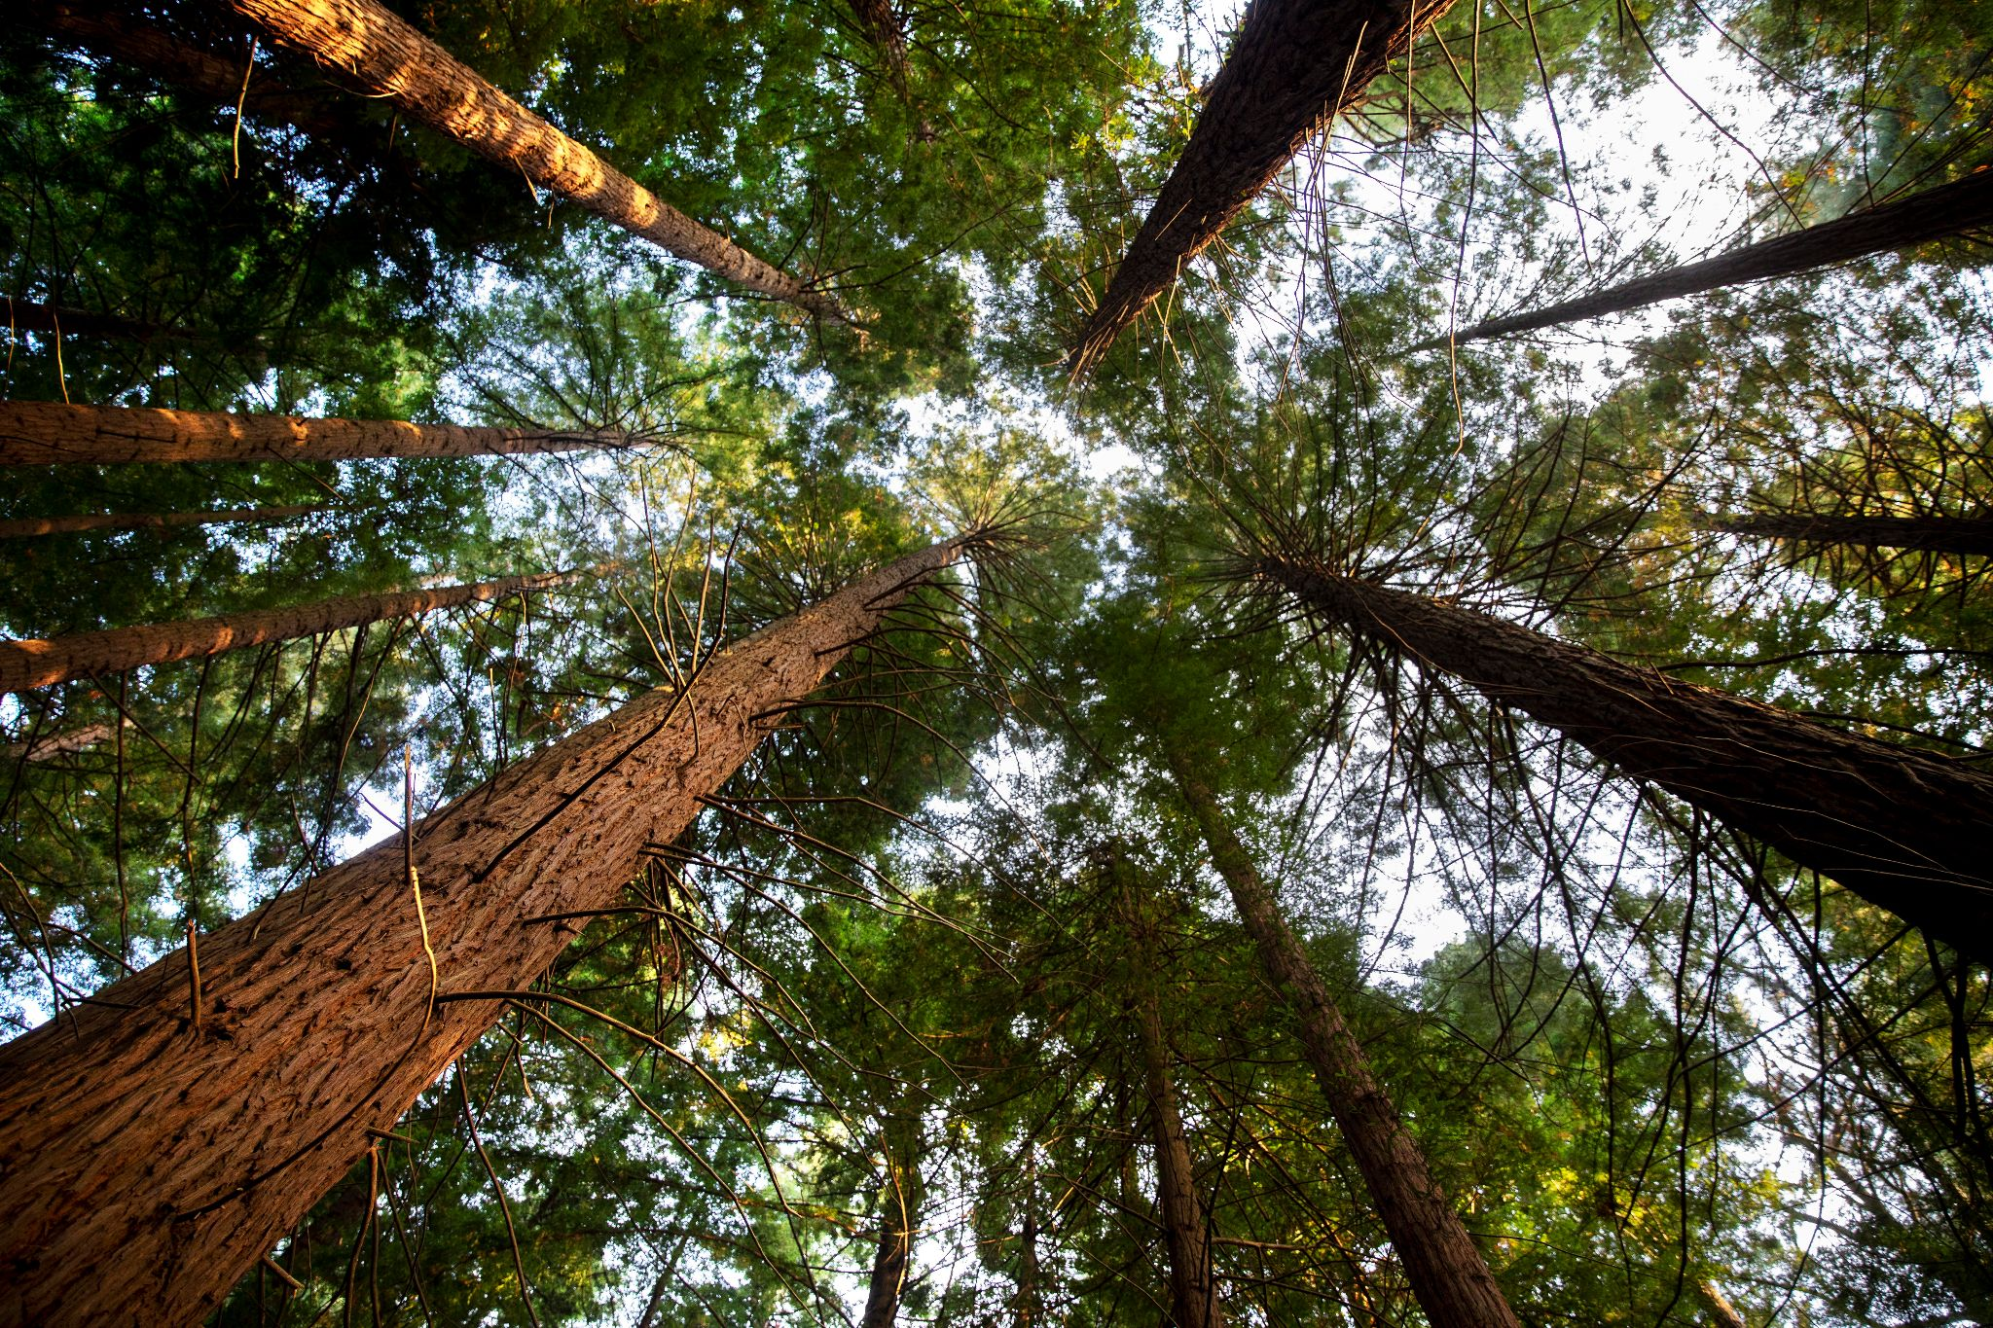
Let’s hear what is Naruto and Boruto…..

Slide 3


What’s the difference between reforestation and afforestation?
Reforestation is replanting trees in areas that were deforested, while afforestation is planting trees in places that were never forested before.

Slide 4
Got it! How does that help with climate change?
Both practices restore ecosystems and increase carbon sequestration, which helps absorb CO2 from the atmosphere.

Slide 5
That sounds effective! So, planting trees can really combat climate change?
Absolutely! It also supports biodiversity and improves air quality. It’s a win-win!

Slide 6

Restoring ecosystems through reforestation and afforestation is a powerful testament to our commitment to healing the planet. As we nurture our forests, we not only sequester carbon but also cultivate hope, biodiversity, and a legacy of environmental stewardship for generations to come….

